Slide 1
OS Lab 2 Presentation
946350, Yoshi, Shih-Chieh Huang
PADS, CS, NTHU, Taiwan

Slide 2
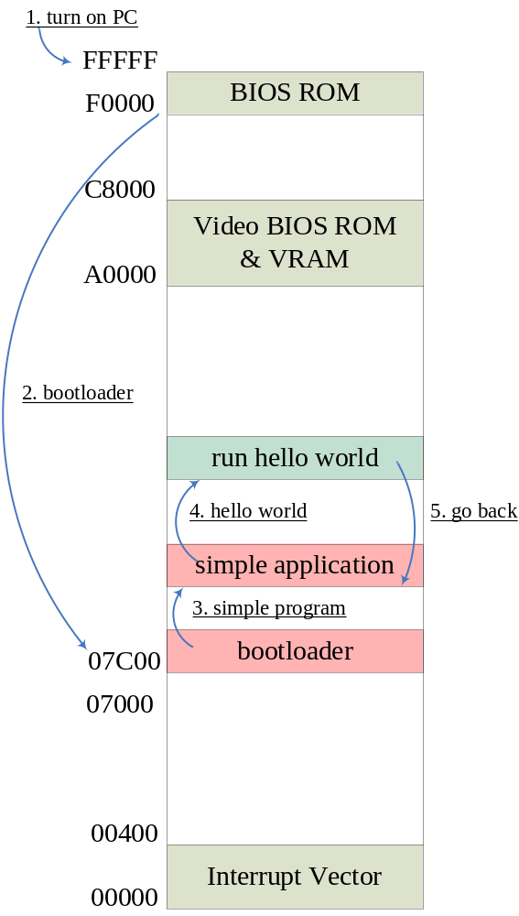
Memory Map
Scheduler is at 0x80000
Hello1 is at 0x10000
Hello2 is at 0x20000
Hello2
20000
Hello1
10000
Scheduler
08000

Slide 3
Context Switch
Push ax, bx, cx, …
Hello1 or
Hello2?
Check 0800:0100
Assume applications have set their own ss, sp
A better way is to write the context to the memory of scheduler
But,
I spent my time trying bonus
Write sp to memory
0800:0102 or 0800:0104
And write pid to 0800:0100
Change state to HelloX
Restore sp from mem
Pop ax, bx, cx, …

Slide 4
Bonus
INT 1Ch
This interrupt is automatically called on each clock tick by the INT 08 handler
This is the preferred interrupt to chain when a program needs to be invoked regularly

Slide 5
HOOK INT 1Ch
0000:0070 for offset
0000:0072 for segment
Refer to a virus code
  Cli
  mov ax,cs
  mov cx,offset Int_1c_Handler+mem_offset
  mov word ptr ds:[70],cx
  mov word ptr ds:[72],ax ;Hook Int 1C
  sti
My code
HOOK_INT1C:
  cli
  mov cx, YIELD ; YIELD int. Handler
  mov ax, ds
  mov dx, 0x0000
  mov ds, dx
  mov [0x0070], cx
  mov [0x0072], ax
  sti

Slide 6
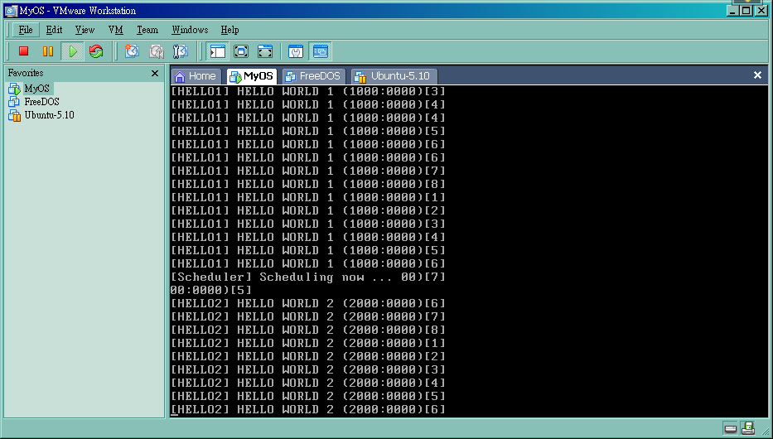
Running screen

Slide 7
Finally
I did the bonus, but still has a bug
I haven’t found out where the bug is
Some interesting website I refer to
  http://moab.eecs.wsu.edu/~cs460/int.html (similar course)
  http://www.totallygeek.com/vscdb/l/lockout_asm.php (a virus hacking site)

